Slide 1
Full Stack Application Development
Server Side: Implementing Web Services
gRPC
gRPC-Introduction
Akshaya Ganesan

Slide 3
gRPC- An RPC library and framework
Problems with RPC- laid the motivation for gRPC
In 2015, Google released gRPC , a modern, open source, high-performance remote procedure call (RPC) framework that can run anywhere.
An interprocess communication technology that allows you to connect, invoke, operate, and debug distributed heterogeneous applications as easily as making a local function call.

Slide 4
gRPC
What does the "g" in gRPC actually stand for?
Its not Google
Google changes the meaning of the "g" for each version
Refer to the README doc
https://github.com/grpc/grpc/blob/master/doc/g_stands_for.md

Slide 5
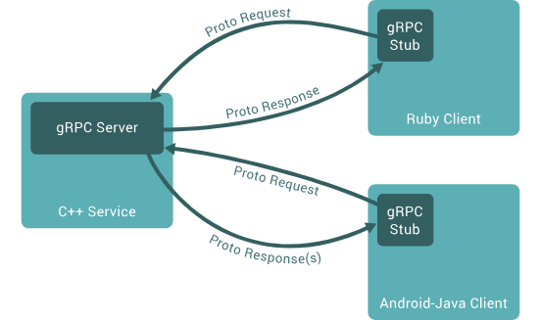
gRPC- Architecture
A service Definition is created.
Using that service definition, the server-side code known as a server skeleton is generated
On the server side, the server implements the service, and runs a gRPC server to handle client calls.
On the client side, the client has a stub that provides the same methods as the server.
gRPC uses Protocol Buffers as
Interface Definition Language (IDL) and
message interchange format.
Image Source: https://grpc.io/docs/what-is-grpc/introduction/

Slide 6
Protocol Buffers
gRPC uses protocol buffers as the Interface Definition Language to define the service interface
Protocol Buffers are a language-neutral, platform-neutral extensible mechanism for serializing structured data.
The service interface definition is specified in a proto file -an ordinary text file with a .proto extension.
The service definition specified in the .proto file, is used by both the server and client sides to generate the code.

Slide 7
Protocol Buffers
Protocol buffer data is structured as messages.
Each message is a small logical record of information containing a series of name-value pairs called fields.
Example:
message Person
{
string name = 1;
int id = 2;
string description = 3;
}

Slide 8
Protocol Buffers
You define gRPC services in ordinary proto files, with RPC method parameters and return types specified as protocol buffer messages.
Example:
service ProductInfo
{
rpc addProduct(Product) returns (ProductID);
rpc getProduct(ProductID) returns (Product);
}
message Product
{
string id = 1;
string name = 2;
string description = 3;
}
message ProductID
{
string value = 1;
}

Slide 9
gRPC Service
The service definition can be used to generate the server or client-side code using the protocol buffer compiler protoc.
Since gRPC service definitions are language agnostic, you can generate clients and servers for any supported language

Slide 10
gRPC Service
Server Side:
Implement the service logic of the generated service skeleton by overriding the service base class.
Run a gRPC server to listen for requests from clients and return the service responses.
Client Side:
The client stub provides the same methods as the server, which your client code can invoke.
The client stub translates them to remote function invocation network calls that go to the server side.

Slide 11
gRPC
gRPC architecture
Protocol Buffers

Slide 12
Thank You!

